Slide 1
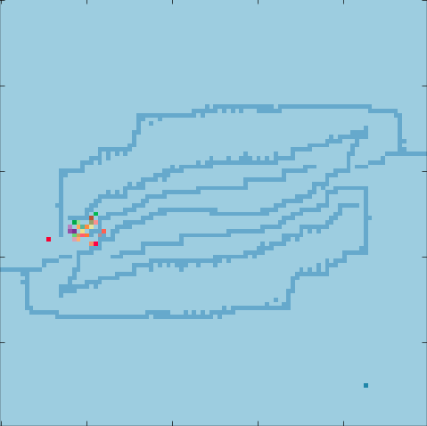
Multi-Agent Pathing under constrained conditions
“How do you go from A to B? when...”
Most agents lack global data
A
Agents communicate with little bandwidth
Limited computation
B
Jose Navarro

Slide 2


E-commerce sales for Q4 2008:
$37.1 Billion
E-commerce sales for Q1 2017:
$105.1 Billion
More people are clicking
More packages

Slide 3
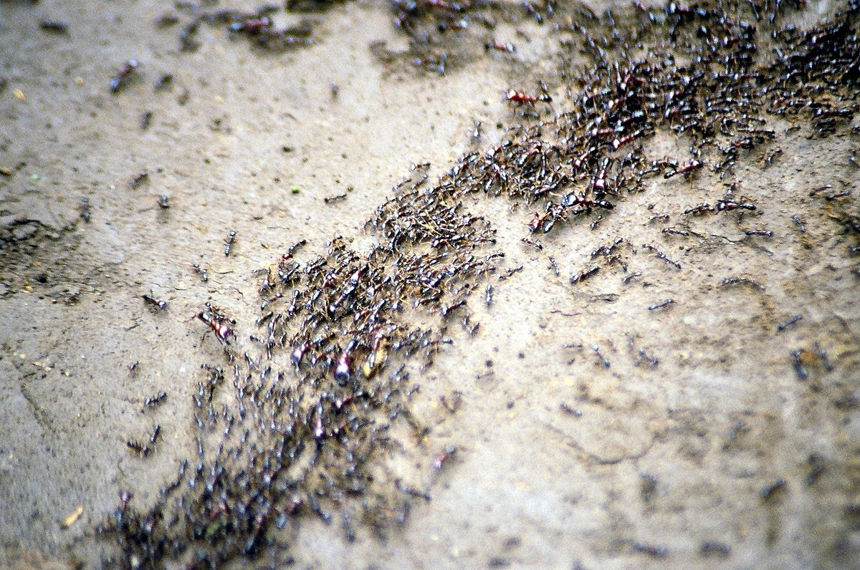


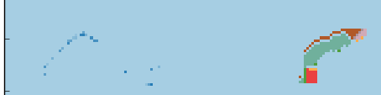
What can go wrong?
Pheromones
Breadth First Search (BFS)

Slide 4
Putting it together
Pheromone Map

